Slide 1

Customer Segmentation & Churn Prediction Dataset: Telco Customer Churn Author: Your Name

Slide 2
Problem Statement
High churn rates impact revenue.
Need segmentation + churn prediction to improve retention.

Slide 3
Data Overview
7,043 customers
Features: demographics, services, tenure, churn flag
Key target: Churn

Slide 4
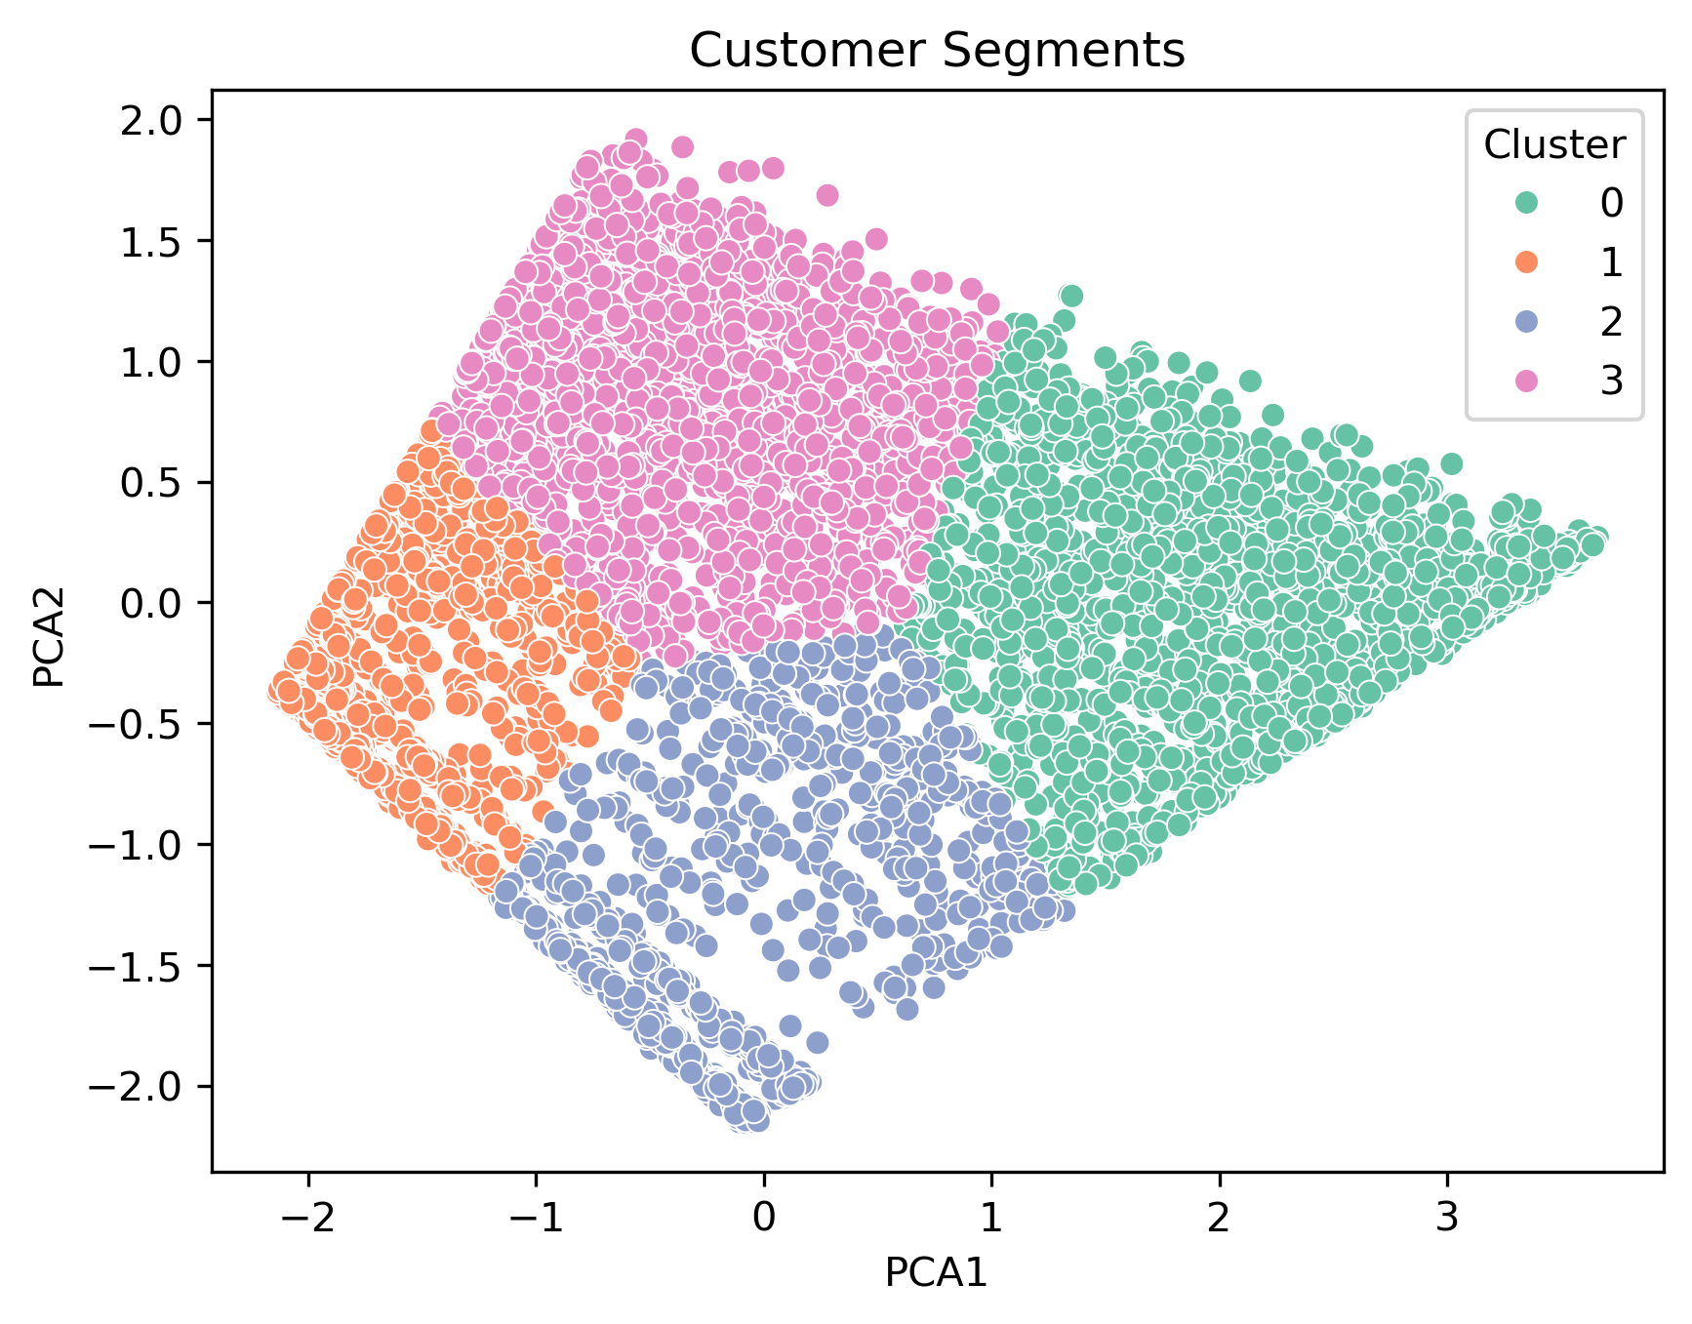
Segmentation Results
4 customer clusters identified using K-Means (k=4).
Visual: PCA scatter plot with 4 different colors representing clusters.
Key Insights:
Cluster 0: High-value, frequent purchasers.
Cluster 1: Mid-value customers with moderate frequency.
Cluster 2: Low-value customers with low purchase frequency.
Cluster 3: Price-sensitive or occasional customers.

Slide 5
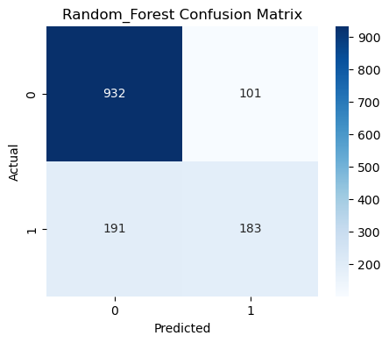
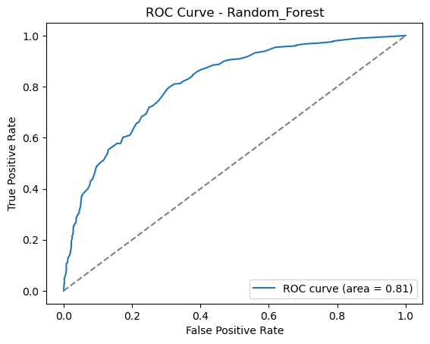
Churn Prediction Results
Random Forest performed best (F1-score, ROC-AUC).
Show confusion matrix and ROC curve.

Slide 6
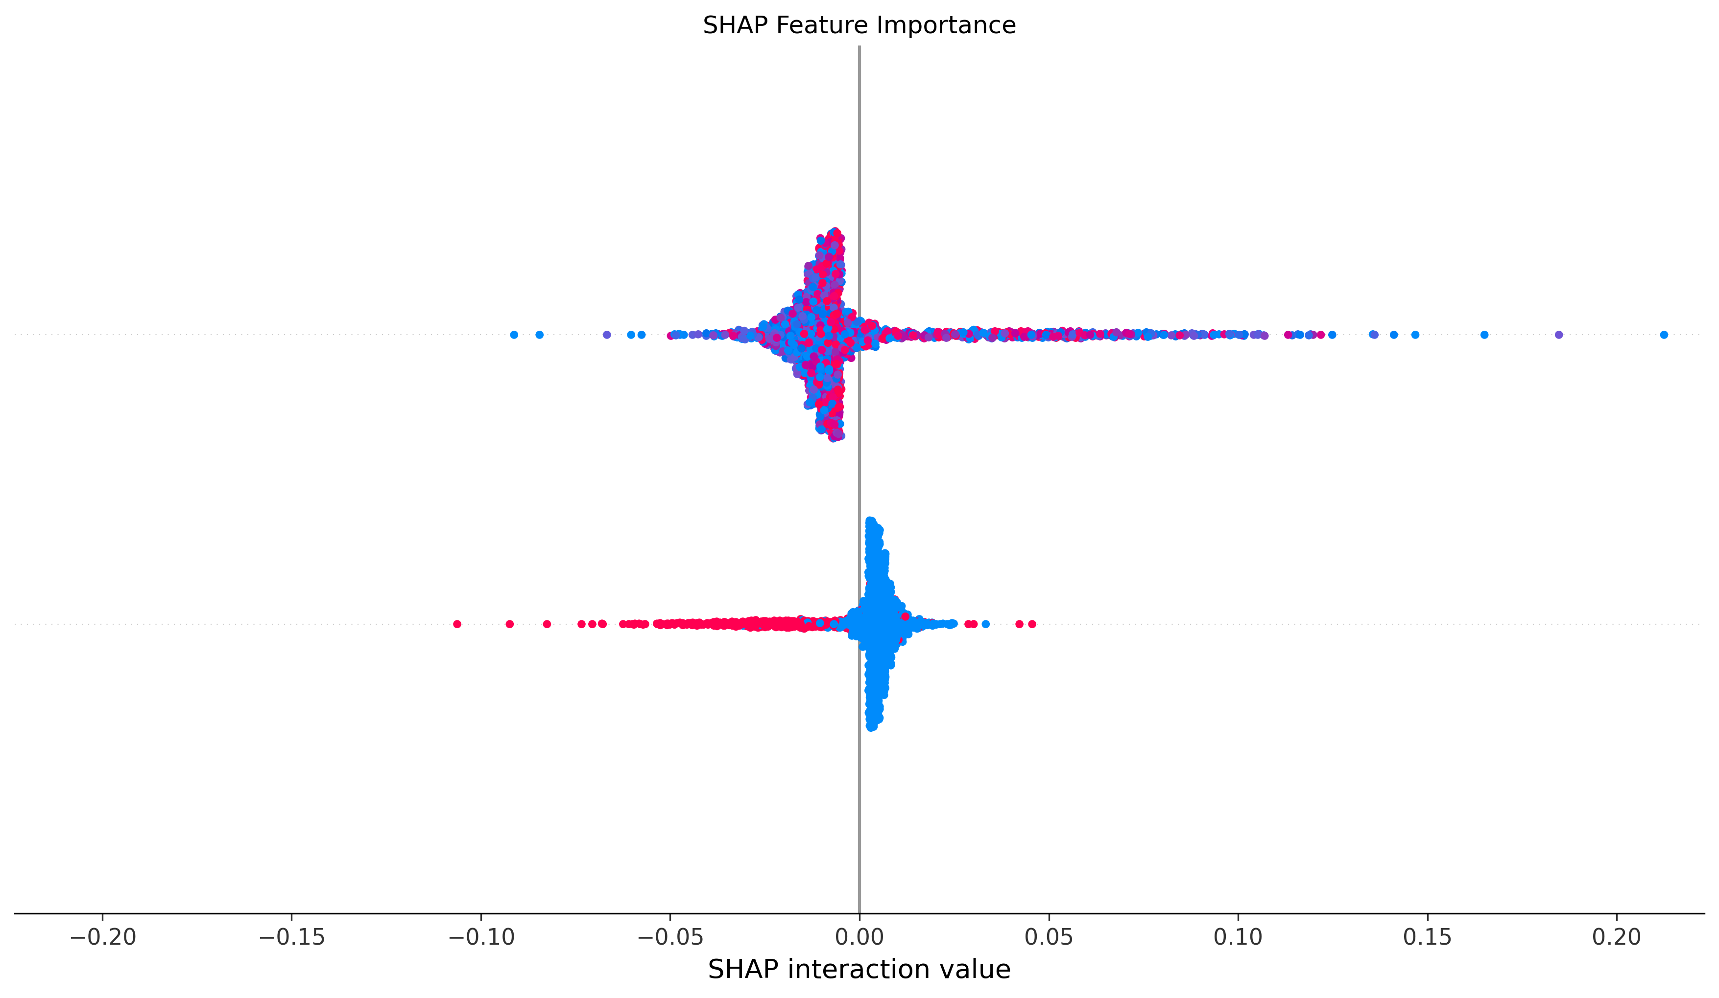
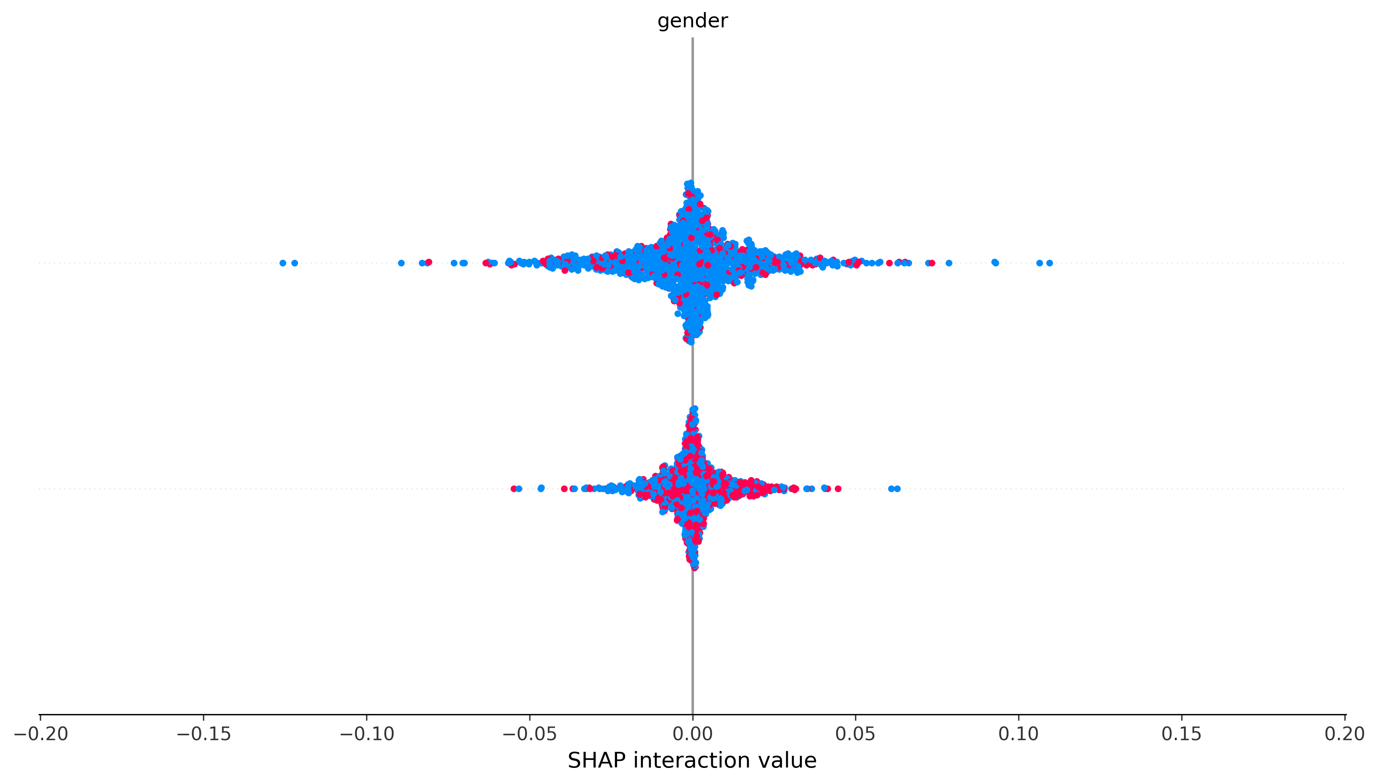
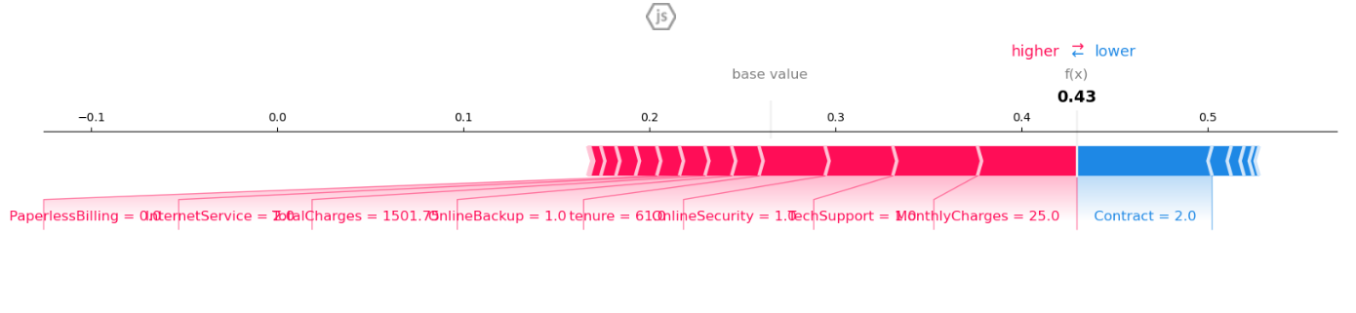
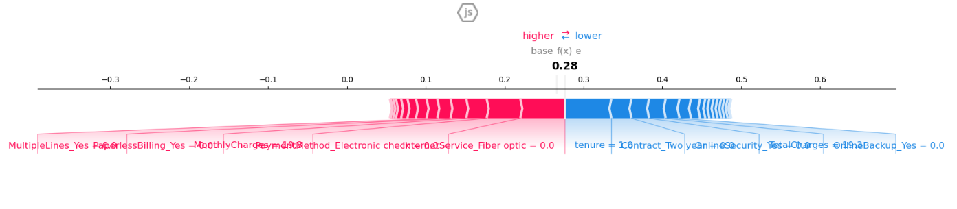
SHAP Explanations
Key drivers of churn: tenure, contract type, services.
Insert force plot PNG and SHAP summary plot.
Add the SHAP force plot and SHAP summary/beeswarm plot from the segmentation project.
Also include the SHAP force plot and SHAP summary plot from the churn project.

Slide 7
Business Recommendations
Incentives for high-risk segments.
Upsell to loyal clusters.

Slide 8
Next Steps
Deploy churn predictor to a dashboard.
Automate retraining on new data.

